Slide 1
Day 3: Sharing plans, data and code
Anna Nowakowska, Mahmoud Elsherif, David Souto
School of Psychology and Vision Sciences

Slide 2
Session 3: Publishing
Pre-printing, reporting guidelines, picking journals, peer review

Slide 3
Pre-printing
File-drawer problem
Gatekeeping
Publication delays

Slide 4
Reporting guidelines

Slide 5
Pick a journal
ROMEO

Slide 6
Data and materials sharing
Allow to reproduce results independently
Detection of questionable practices / makes studies auditable
Prevents permanent data loss
Fosters a higher standard of data management: The kind that would survive changes in institutions / experimenter’s demise / obsolete computers
Can be a funder / publisher requirement
See: The Sin of Data Hoarding, Chapter 4 of Seven Sins of Psychology by Chambers and Psychology’s renaissance by Nelson, Simmons and Simonsohn in Annual Review of Psychology

Slide 7
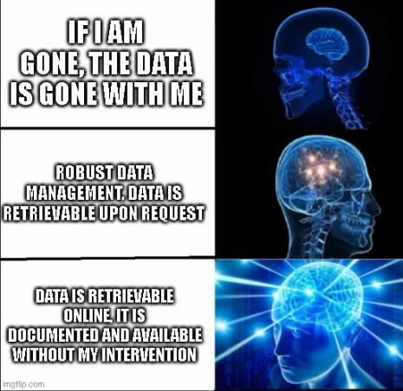
Why share data / Materials
“Data available upon reasonable request”:
Jelte Wicherts study in 2006 found 73% failed to comply after 6 months
Evidence that studies with shared data are more trustworthy (less statistical errors)
Broadening project impact.
Moral imperative
Notes:
Moral imperative: Aren’t participant’s / funders / institutions expectations that their data has as much impact as possible while preserving confidentiality / anonymity? Use of public money (university overheads, student fees).

Slide 8
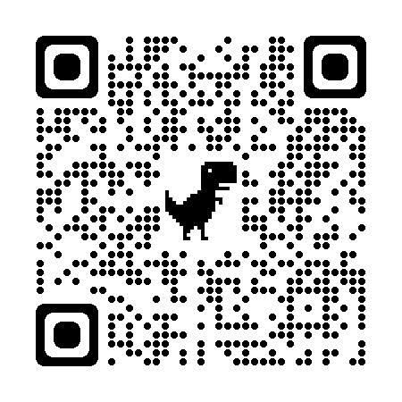
What is FAIR?
Rather recent data management and stewardship standards: “The intent is that these may act as a guideline for those wishing to enhance the reusability of their data holdings.”
Findable – Persistent identifiers, rich metadata, indexed
Accessible – Via standard protocol, authorization procedure if necessary
Interoperable – Can be incorporated in other workflows
Reusable – Licensing / domain standards / documentation
Wilkinson, M., Dumontier, M., Aalbersberg, I. et al. The FAIR Guiding Principles for scientific data management and stewardship. Sci Data 3, 160018 (2016). https://doi.org/10.1038/sdata.2016.18
Notes:
Interoperability: the ability of data or tools from non-cooperating resources to integrate or work together with minimal effort.

Slide 9
Share data & materials: What’s FAIR?

Slide 10
Practicalities in sharing data
Anonymous links to data / code during reviewing
Hosting data: Pick the platform that will add the most value
OSF
Zanado?
Share as much as you can given ethical implications.
Facilitates the work of others.
Metanalyses.
Enhances the value of your work.

Slide 11
Peer review
What should you expect?

Slide 12
Manuscript versions
Update the author manuscript (you have the copyright) alongside the published version (you might have not!)

Slide 13
Workshop feedback

